Slide 1


CSE 455 Software Testing
Lecture 2
This course is offered to the students of BS Software Engineering who are enrolled in 8th semester

Slide 2
Course instructor Yella mehroze
yellamehroze@cuilahore.edu.pk

Slide 3
Outline
Why Software Testing? Motivation
What we do
What does a Software Tester Do?
What Makes a Good Software Tester?
Goals for Testing
Testing Methodologies
Testing Axioms
7 Principals of Software Testing

Slide 4
Introduction
Back in 1947, the Mark II computer required programmers to constantly maintain it.
The average person never conceived of having his own computer in his home.
Now software available in CD’s or online
More software in our kids’ video games than on the space shuttle
What once were techie gadgets, such as cell phones, have become commonplace.
Most of us now can’t go a day without logging on to the Internet and checking our email
Software is everywhere
However, it’s written by people—so it’s not perfect

Slide 5

Why Software Testing? Motivation I
The Lion King Animated Storybook, Fall 1994
Disney’s first multimedia CD-ROM game for children.
Highly promoted and advertised
Sales were huge
The game to buy for children that
holiday season

Slide 6
Why Software Testing? Motivation I
The Lion King Animated Storybook, Fall 1994
On December 26, Disney's customer support phones began to ring, and ring, and ring….from angry parents with crying children who couldn't get the software to work.
Numerous stories appeared in newspapers and on TV news.
Disney failed to properly test the software on many different PC models available on the market.
The software worked on a few systems and failed on many very popular PC platforms!

Slide 7
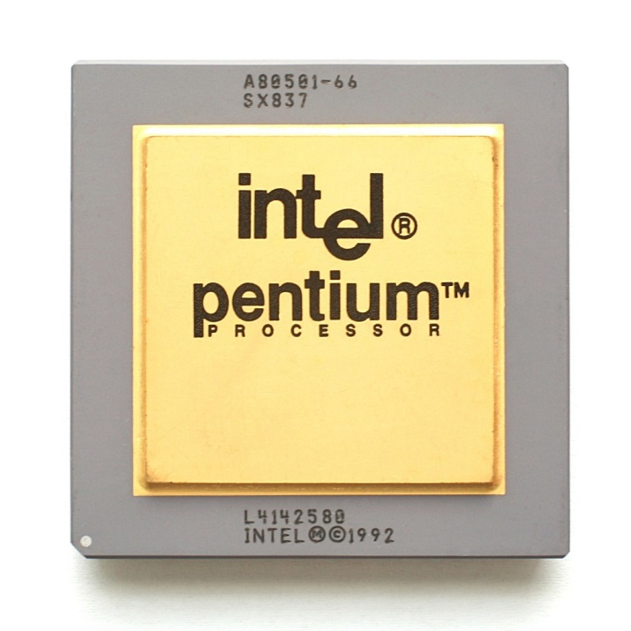
Why Software Testing? Motivation II
Intel Pentium Floating-Point Division Bug, 1994
Enter the following equation into your PC's calculator:
(4195835 / 3145727) * 3145727 – 4195835
What is the result?

Slide 8
Why Software Testing? Motivation II
Intel Pentium Floating-Point Division Bug, 1994
If you get anything else except zero, you have an old Intel Pentium CPU with a floating-point division bug, a software bug burned into a computer chip.
It is reproduced over and over in the manufacturing process
On October 30, 1994, Dr. Thomas R. Nicely of Lynchburg (Virginia) College traced an unexpected result from one of his experiments to an incorrect answer by a division problem solved on his Pentium PC.
He posted his findings on the Internet and soon afterward a firestorm erupted as numerous other people duplicated his problem and found additional situations that resulted in wrong answers.
Fortunately, these cases were rare and resulted in wrong answers only for extremely math-intensive, scientific, and engineering calculations
Other people never encounter them doing their taxes or running their businesses.

Slide 9
Why Software Testing? Motivation II
Intel Pentium Floating-Point Division Bug, 1994
What makes this story notable is the way Intel handled the situation:
Their software test engineers had found the problem while performing their own tests before the chip was released. Intel’s management decided that the problem wasn’t severe enough to warrant fixing it, or even publicizing it.
Once the bug was found, Intel attempted to diminish its perceived severity through press releases and public statements.
When pressured, Intel offered to replace the faulty chips, but only if a user could prove that he was affected by the bug.

Slide 10
Why Software Testing? Motivation II
Intel Pentium Floating-Point Division Bug, 1994
Internet newsgroups were jammed with customers demanding that Intel fix the problem
News stories painted the company as uncaring and incredulous
Intel apologized for the way it handled the bug and took a charge of over $400 million to cover the costs of replacing bad chips
Intel now reports known problems on its Web site and carefully monitors customer feedback on Internet newsgroups
Notes:
Incredulous-> doubtful

Slide 11
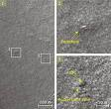
Why Software Testing? Motivation III
NASA Mars Polar Lander, 1999
On December 3, 1999, NASA's Mars Polar Lander disappeared during its landing attempt on the Martian surface.
A Failure Review Board investigated the failure and determined that the most likely reason for the malfunction was the unexpected setting of a single data bit.
Most alarming was why the problem wasn't caught by internal tests.
NASA Mars Polar Lander Crash Site

Slide 12
Why Software Testing? Motivation III
NASA Mars Polar Lander, 1999
The plan for landing was decided in theory
To save money, NASA simplified the mechanism
The Failure Review Board discovered in their tests identified the fatal bit
The result was catastrophic, but the reason behind it was simple
The lander was tested by multiple teams
The first team never looked to see if the fatal bit was set—it wasn’t their area
The second team always reset the computer, clearing the bit, before it started its testing
Both pieces worked perfectly individually, but not when put together.

Slide 13
Why Software Testing? Motivation IV
Malaysia Airlines jetliner, August 2005
As a Malaysia Airlines jetliner started journey from Perth, Australia, to Kuala Lumpur, Malaysia, it suddenly took on a mind of its own and zoomed 3,000 feet upward.
The captain disconnected the autopilot and pointed the Boeing 777’s nose down to avoid stalling, but was jerked into a steep dive. He throttled back sharply on both engines, trying to slow the plane. Instead, the jet raced into another climb.
The crew eventually regained control and manually flew their 177 passengers safely back to Australia.
Investigators quickly discovered the reason for the plane’s roller-coaster ride 38,000 feet above the Indian Ocean. A defective software program had provided incorrect data about the aircraft’s speed and acceleration, confusing flight computers. The computers had also failed, at first, to respond to the pilot’s commands.

Slide 14

Why Software Testing? Motivation V
Patriot Missile Defense System, 1991
U.S. Patriot missile defense system is a scaled-back version of the Strategic Defense Initiative.
Used in Gulf War as a defense for Iraqi Scud missiles.
It failed to defend against several missiles, including one that killed 28 U.S. Soldiers.
A small timing error in the system’s clock accumulated to the point that after 14 hours, the tracking system was no longer accurate. And during that incident the system was working for more than 100 hours.

Slide 15
Why Software Testing? Motivation VI
The Y2K (Year 2000) Bug
In early 1970s a programmer (lets say Mr. Dave) developed a system (Payroll System) while little memory for storage was available.
One method he used was to shorten dates from their 4-digit format, to a 2-digit format (1973 to 73).
He considered the problems when the current year will be 2000. But assumed that system will be replaced by then.
In late 1990s his program was still used but Dave was retired and no one knows if the program is Y2K compliant or not.
It’s estimated that several hundred billion dollars were spent, worldwide, to replace computer programs such as Dave’s

Slide 16
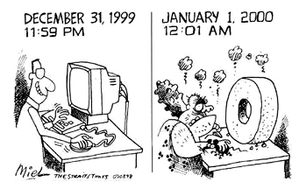
Question?
In the Year 2000 bug example, did Dave do anything wrong?

Slide 17
What Makes a Good Software Tester?
They are explorers
They are troubleshooters
They are relentless (continuous)
They are creative
They are (mellowed) perfectionists they exercise good judgment
They are tactful and diplomatic
They are convincing

Slide 18
What Makes a Good Software Tester?
They are explorers
They love to get a new piece of software, install it on their PC, and see what happens
They are troubleshooters
Software testers are good at figuring out why something doesn’t work. They love puzzles.
They are relentless (continuous)
Software testers keep trying. They may see a bug that quickly vanishes or is difficult to re-create.
They are creative
Their job is to think up creative and even off-the-wall approaches to find bugs
They are (mellowed) perfectionists
They strive for perfection, but they know when it becomes unattainable and they’re OK with getting as close as they can

Slide 19
What Makes a Good Software Tester?
They exercise good judgment
Software testers need to make decisions about what they will test, how long it will take, and if the problem they’re looking at is really a bug
They are tactful and diplomatic
Software testers are always the bearers of bad news. They have to tell the programmers that their baby is ugly. Good software testers know how to do so tactfully and professionally
They are convincing
Bugs that testers find won’t always be viewed as severe enough to be fixed. Testers need to be good at making their points clear, demonstrating why the bug does indeed need to be fixed
Software Testing is Fun

Slide 20
What Exactly Does a Software Tester Do?
The goal of a software tester is to find bugs.
The goal of a software tester is to find bugs, and find them as early as possible.
The goal of a software tester is to find bugs, find them as early as possible, and make sure they get fixed.

Slide 21
Goals for Testing
The main focus of testing and test design should be bug prevention
If bugs not prevented, testing and test design should be able to discover symptoms caused by bugs
Finally there should be clear diagnoses so that bugs can be easily corrected

Slide 22
Goals for Testing
Prevention:
A prevented bug is better than a detected and corrected bug
If bug is prevented
No code to correct
No retesting is needed
No one is embarrassed
No memory is consumed
No delays in schedule
Designing tests is one of the best preventers
Test design eliminates bugs at every stage in the creation of software, from conception to specification, to design, coding and rest

Slide 23
Goals for Testing
Discovery:
This is the secondary goal of testing
A bug is manifested in deviation from excepted behavior
A test design must document expectations, test procedure and results of actual test
Different bugs can have same manifestations and one bug can have many symptoms
Notes:
manifested[-> visible, evidence

Slide 24
Testing Methodologies
Black box testing
No knowledge of internal program design or code required.
Tests are based on requirements and functionality.
White box testing
Knowledge of the internal program design and code required.
Tests are based on coverage of code statements, branches, paths, conditions.

Slide 25
Testing Axioms
Following are testing axioms
It’s Impossible to Test a Program Completely
Software Testing Is a Risk-Based Exercise
Testing Can’t Show That Bugs Don’t Exist
The More Bugs You Find, the More Bugs There Are
The Pesticide Paradox
Not All the Bugs You Find Will Be Fixed
When a Bug’s a Bug Is Difficult to Say
Product Specifications Are Never Final
Software Testers Aren’t the Most Popular Members of a Project Team
Software Testing Is a Disciplined Technical Profession

Slide 26
It’s Impossible to Test a Program Completely
This is due to the following four reasons
The number of possible inputs is very large.
The number of possible outputs is very large.
The number of paths through the software is very large.
The software specification is subjective. You might say that a bug is in the eye of the beholder.
Multiply all these “very large” possibilities
You get a set of test conditions that’s too large to attempt

Slide 27
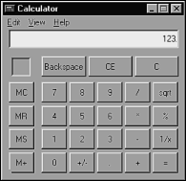
It’s Impossible to Test a Program Completely
Even a simple program such as the Windows Calculator is too complex to completely test.
If you decide to eliminate any of the test conditions due to following reasons, you’ve decided not to test the program completely
They’re redundant
They’re unnecessary
or just to save time

Slide 28
Software Testing Is a Risk-Based Exercise
If you decide not to test every possible test scenario, you’ve chosen to take on risk
When the product has to be released, so you will need to stop testing, but if you stop too soon, there will still be areas untested
A customer will still use the untested areas of the product, and he or she will discover the bug
It’ll be a costly bug then
Testers need to learn
How to reduce the huge domain of possible tests into a manageable set
How to make wise risk-based decisions on what’s important to test and what’s not

Slide 29
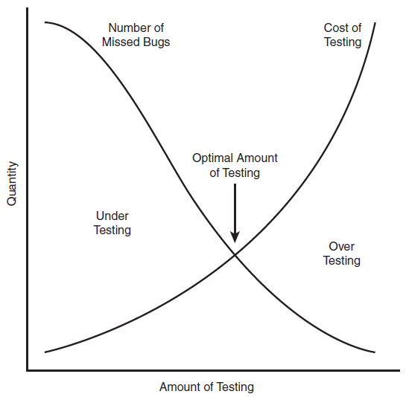
Software Testing Is a Risk-Based Exercise
Every software project has
an optimal test effort.

Slide 30
Testing Can’t Show That Bugs Don’t Exist
Software testing can show that bugs exist, but it can’t show that bugs don’t exist
You can perform your tests, find and report bugs, but at no point you can guarantee that there are no longer any bugs to find
You can only continue your testing and possibly find more and more bugs

Slide 31
The More Bugs You Find, the More Bugs There Are
There are even more similarities between real bugs and software bugs
If you see one, odds are there will be more nearby.
There are several reasons for this
Programmers have bad days:
Like all of us, programmers can have off days.
Code written one day may be perfect;
Code written another may be sloppy.
One bug can be a tell-tale sign that there are more nearby.

Slide 32
The More Bugs You Find, the More Bugs There Are
Programmers often make the same mistake:
Everyone has habits. A programmer who is prone to a certain error will often repeat it.
Some bugs are really just the tip of the iceberg:
Very often the software’s design or architecture has a fundamental problem.
A tester will find several bugs that at first may seem unrelated but eventually are discovered to have one primary serious cause.

Slide 33
The Pesticide Paradox
The more you test software, the more immune it becomes to your tests
The same thing happens to insects with pesticides
If you keep applying the same pesticide, the insects eventually build up resistance and the pesticide no longer works.
The test process repeats each time around the loop just like spiral model of development
After several passes, all the bugs that those tests would find are exposed, continuing to run them won’t reveal anything new
To overcome this, software testers must continually write new and different tests to exercise and find more bugs.

Slide 34
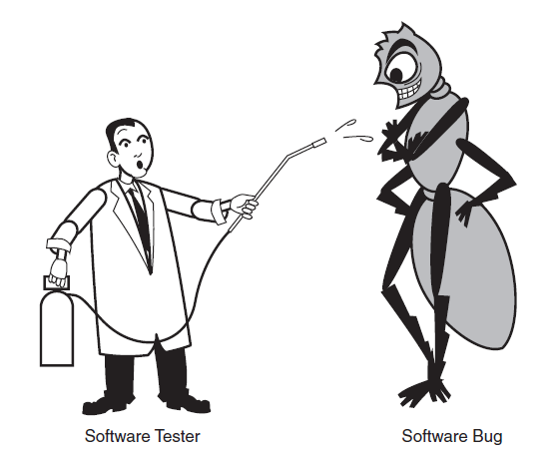
The Pesticide Paradox
Software undergoing the same repetitive tests eventually builds up resistance to them.

Slide 35
Not All the Bugs You Find Will Be Fixed
One of the sad realities of software testing is that not every bug you find will be fixed
Don’t be disappointed
This doesn’t mean that you’ve failed in achieving your goal as a software tester
It also does not mean that you or your team will release a poor quality product
It does mean that you need to exercise good judgment and know when perfection isn’t reasonably attainable
You need to decide which bugs will be fixed and which ones won’t.

Slide 36
Not All the Bugs You Find Will Be Fixed
There are following reasons why you might choose not to fix a bug:
There’s not enough time.
In every project there are always too many software features, too few people to code and test them. They do not find enough room left in the schedule to finish.
Example: If you’re working on a tax preparation program, April 15 isn’t going to move
It’s really not a bug:
“It’s not a bug, it’s a feature!” It’s not uncommon for misunderstandings, test errors, or spec changes to result in would-be bugs being dismissed as features.
Notes:
Dismiss -> leave

Slide 37
Not All the Bugs You Find Will Be Fixed
It’s too risky to fix:
Software is fragile, intertwined, and sometimes like spaghetti. You might make a bug fix that causes other bugs to appear.
Under the pressure to release a product under a tight schedule, it might be better to leave in the known bug to avoid the risk of creating new, unknown ones.
It’s just not worth it:
Following types of bugs are not removed
Bugs that would occur infrequently
Bugs that appear in little-used features.
Bugs that have, work-around ways that a user can prevent or avoid the bug
The decision-making process usually involves
software testers
project managers
programmers

Slide 38
When a Bug’s a Bug Is Difficult to Say
If there’s a problem in the software but no one ever discovers it—not programmers, not testers, and not even a single customer—is it a bug?
???

Slide 39
When a Bug’s a Bug Is Difficult to Say
The problem is that there’s no definitive answer
The answer is based on what you and your development team decide works best for you.
Recall the rules discussed earlier for the bugs to be called bugs
One opinion is to claim that the software does or doesn’t do “something” implies that the software was run and that “something” or the lack of “something” was witnessed
You can’t report on what you didn’t see
You can’t claim that a bug exists if you didn’t see it

Slide 40
When a Bug’s a Bug Is Difficult to Say
The other opinion is it’s not uncommon for two people to have completely different opinions on the quality of a software product
One may say that the program is incredibly buggy and the other may say that it’s perfect
How can both be right?
???

Slide 41
When a Bug’s a Bug Is Difficult to Say
Answer:
One has used the product in a way that reveals lots of bugs. The other hasn’t.
It is just like:
“If a tree falls in the forest and there’s no one there to hear it, does it make a sound?”

Slide 42
Product Specifications Are Never Final
The industry is moving so fast that last year’s cutting-edge products are obsolete this year
Software is getting larger and gaining more features and complexity, resulting in longer and longer development schedules
The result is a constantly changing product specification
There’s no other way to respond to the rapid changes
Example:
You’re halfway through the planned two year development cycle, and your main competitor releases a product very similar to yours but with several desirable features that your product doesn’t have.
Do you continue with your spec as is and release an inferior product in another year?

Slide 43
Product Specifications Are Never Final
As a software tester, you will observe that features will be added that you didn’t plan to test.
Features will be changed or even deleted that you had already tested and reported bugs on
You need to be flexible in your test planning and test execution

Slide 44
Software Testers Aren’t the Most Popular Members of a Project Team
Recall the job of a software tester
Inspect and critique peer’s work
Find problems with it
Publicize what you’ve found
Can you win a popularity contest doing this job???
Following are the tips to keep the peace with your fellow teammates:
Find bugs early:
It will be more appreciated if you find a serious bug three months before, rather than one day before, a product’s scheduled release

Slide 45
Software Testers Aren’t the Most Popular Members of a Project Team
Temper your enthusiasm
You get really excited when you find a terrible bug. But, if you bounce into a programmer’s cubicle with a huge grin on your face and tell her that you just found the nastiest bug of your career and it’s in her code, she won’t be happy.
Don’t always report bad news:
If you find a piece of code surprisingly bug free, tell the world.

Slide 46
Software Testing Is a Disciplined Technical Profession
Software industry has progressed to the point where professional software testers are mandatory.
It’s now too costly to build bad software
To be fair, not every company is on board yet
But most software is now developed with a disciplined approach that has software testers as core, vital members of their staff
It is now a career choice—a job that requires training and discipline, and allows for advancement

Slide 47
7 Principals of Software Testing
Principal 1:
Exhaustive testing is impossible.
Unless the application under test has a very simple logical structure and limited input, it is not possible to test all possible combinations of data and scenarios
We need an optimal amount of testing based on the risk assessment of the application
Principal 2:
Defect Clustering
Most of the reported defects are related to small number of modules within a system
Approximately 80% of the problems are found in 20% of the modules.

Slide 48
7 Principals of Software Testing
Principal 3:
Pesticide Paradox
If the same tests are repeated over and over again, eventually the same test cases will no longer find new bugs.
How to overcome
Test cases need to be regularly reviewed & revised
Adding new & different test cases
Principal 4:
Testing shows presence of defects
Software Testing reduces the probability of undiscovered defects remaining in the software
Even if no defects are found, it is not a proof of correctness.
What if software doesn’t meet the needs & requirements of clients.

Slide 49
7 Principals of Software Testing
Principal 5:
Absence of Error is a Fallacy
Finding and fixing defects does not help if the system build is unusable and does not fulfill the users needs & requirements
Principal 6:
Early Testing
Testing should start as early as possible in the Software Development Life Cycle.
We can start testing as soon as requirements and design documents are available.
So that any defects in the requirements or design phase are captured as well.
When defects are found earlier in the lifecycle, they are much easier and cheaper to fix.

Slide 50
7 Principals of Software Testing
Principal 7:
Testing is context dependent
The way you test an e-commerce site will be different from the way you test a commercial off the shelf application.

Slide 51
7 Principals of Software Testing
Principle 1 | Testing shows presence of defects
Principle 2 | Exhaustive testing is impossible
Principle 3 | Early Testing
Principle 4 | Defect Clustering
Principle 5 | Pesticide Paradox
Principle 6 | Testing is context dependent
Principle 7 | Absence of errors - fallacy

